Slide 1

Movie Production Insights for ABC Company
by Nitin George Cherian( Consultant @XYZ)

Slide 2
Problem Statement
ABC Movie Production Company approaches XYZ agency in the beginning of year 2017
ABC’s Aim: Produce Movies that earn highest Revenue, Rating and Critical Acclaim.
ABC’s Need: Find out characteristics of movies that earn highest Revenue, Rating and Critical Acclaim
ABC also want to know:
Movie Industry Growth ?
Right time to invest in the Movie Industry ?

Slide 3
Background
IMDB(Internet Movie Database): Popular online database of movies, television programs etc.
IMDB Registered users: Rate movies on a scale of 1 to 10.
IMDB Rating: Weight-Mean Rating displayed beside each title.
IMDB also displays Metacritic (Critic Rating).
IMDB Most Popular 1000 movies from 2006-2016 would be ideal for finding insights for ABC’s need

Slide 4
Data in Depth
Dataset is taken from IMDB database
1000 most popular movies by IMDB Rating from 2006-2016
The data consists of the Title of the movie and its corresponding Rank. Rank 1 is the most popular movie. A movie with highest Rating has the highest rank.
The Director and Actors of the movie are listed in the dataset.
The Revenue which the movie generated

Slide 5
Heading
What did you do?

Slide 6
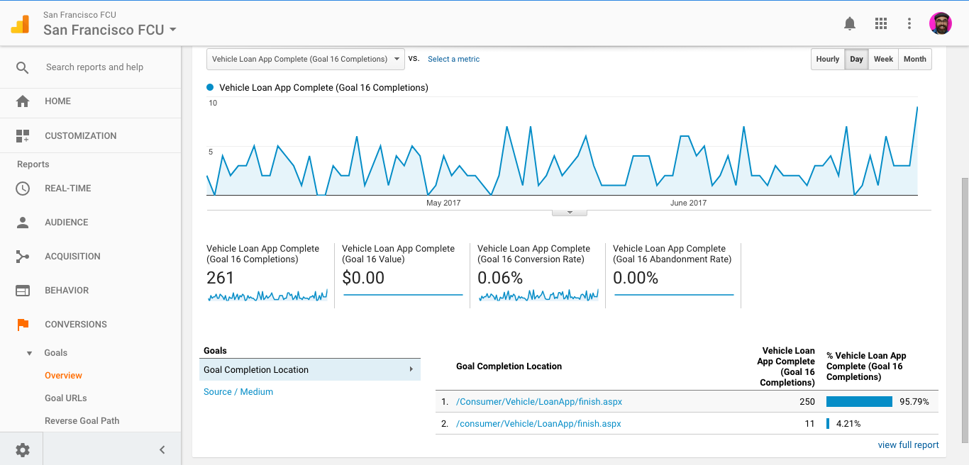
Objectives & Graphs
Tracked in Google Analytics

Slide 7
Objectives & Graphs
Tracked in Google Analytics

Slide 8
Objectives & Graphs
Tracked in Google Analytics

Slide 9
Objectives & Graphs
Tracked in Google Analytics

Slide 10
Conclusion
What did you achieve or learn from this exercise

